Slide 1
Lecture 25: Implementation
Complicating factors
Control design without a model
Implementation of control algorithms

Slide 2
Practical Implementation
Model error
Complexity
Actuator dynamics
Sensor dynamics
Disturbances/noise
Nonlinearities (saturation)
Control implementation
Sampling
D
R
+
E
U
+
Y
Control
Algorithm
Actuator
Plant
-
+
N
Sensor
+
+

Slide 3
Actuator/Sensor Dynamics
Can model using techniques we have learned throughout this course
Often dynamics are fast compared to the plant and controller and hence can be treated as static
Other times dynamics must be modeled
Can attempt to remove sensor altogether and use a model to estimate certain quantities

Slide 4
Sensorless Control
Motivation
Some quantities cannot be measured (battery state of charge, SOC)
Removal of a sensor reduces cost and weight, and improves reliability
Estimator still has dynamics … needs to be faster than rest of system
Concept:
Estimate states using a model of the plant (open-loop)
Use measurements of some states as a correction to the estimates (closed-loop)
Use probabilistic information to “optimally” balance the contribution of the model and the measurement (Kalman Filter)

Slide 5
Sensorless Control
Concept of a state estimator (observer)
There is a duality between estimation and control
U
Actual
Plant
Y
+
Y_{est}
+
Model of
Plant
+
-
K
correction
error in
estimate

Slide 6
Complexity
If it is not desired to disregard some fast dynamics, may be able to decouple system components based on speed
Like what was done with motor control
Fast inner loop first, then slower outer loop

Slide 7
Model Error
Options:
Make system robust to model uncertainty
Attempt to estimate model parameters
State estimation techniques
Adaptive control techniques

Slide 8
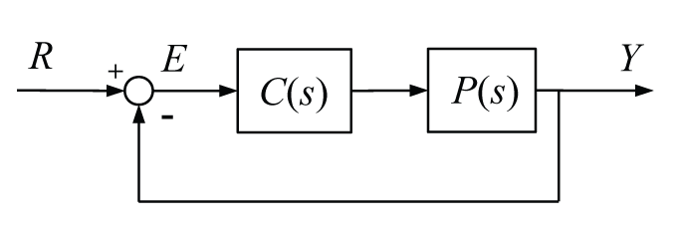
Model Error
Sensitivity function indicates robustness
amount the closed-loop transfer
function changes for a given
change in the plant
M(dB)
ω(rad/sec)

Slide 9
Disturbances
Options
Make system robust to disturbances, be aware of effect on other goals (noise rejection, reference tracking)
“Feed forward” knowledge about the disturbance (if available) to correct the control signal

Slide 10
Noise
Options
Make system robust to noise, be aware of effect on other goals (disturbance rejection, reference tracking)
Use a filter to help improve noise/resonance attenuation properties of the system

Slide 11
Filter Design
Noise signals are in a different frequency range than reference signals (band-pass filter, notch filter)
Filters can add delay if implemented in real time
Noise and reference are in the same frequency range
Kalman filter

Slide 12
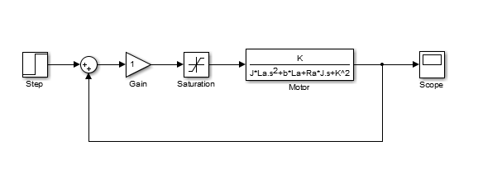
Nonlinearities/Saturation
No real amplifier/actuator can supply infinite control effort, eventually they saturate
Can simulate effect

Slide 13
Saturation
The effect of saturation is that the overall gain is effectively reduced (nonlinearly)
Saturation can cause a problem in that an integrator in the controller will continue to integrate the error (request more control effort) even when the actuator is saturated
One solution is to use an “integrator anti-windup” strategy to switch the integrator off

Slide 14
Control Design without a Model
Throughout this course we have assumed a model on which to base our design
What to do when there is no model
Use intuition about effect of control to tune gains
Use an empirical technique (Ziegler Nichols, many others)
Use trial and error to optimize the resulting behavior (software is available, can be time consuming)

Slide 15
PID Intuition
Some intuition about the effect of the terms of a PID controller
Increasing K_{p}: Same amount of error generates a proportionally larger amount of control … makes system faster, but overshoot more (less stable)
Increasing K_{d}: Allows controller to anticipate an increase in error, adds damping to the system (reduces overshoot)
Increasing K_{i}: Control effort builds as error is integrated over time, helps reduce steady state error, but can be slow to respond
Note: these guidelines do not hold for all situations

Slide 16
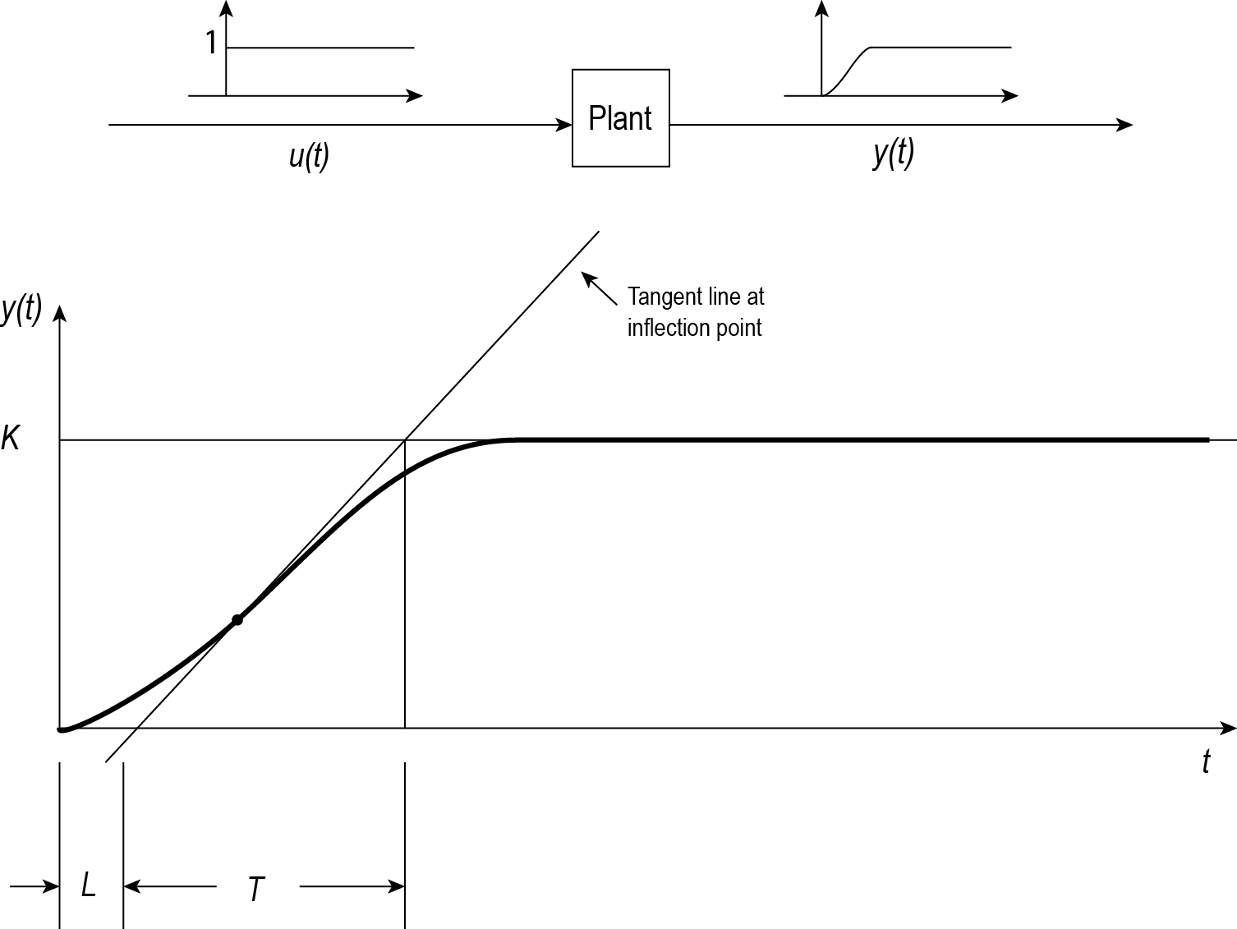
Ziegler Nichols
First Method
Look at open-loop step response of plant, use parameters of response to calculate control gains
Type of Control | Kp | Ti | Td
P | T/L | - | -
PI | 0.9T/L | L/0.3 | -
PID | 1.2T/L | 2L | 0.5L

Slide 17
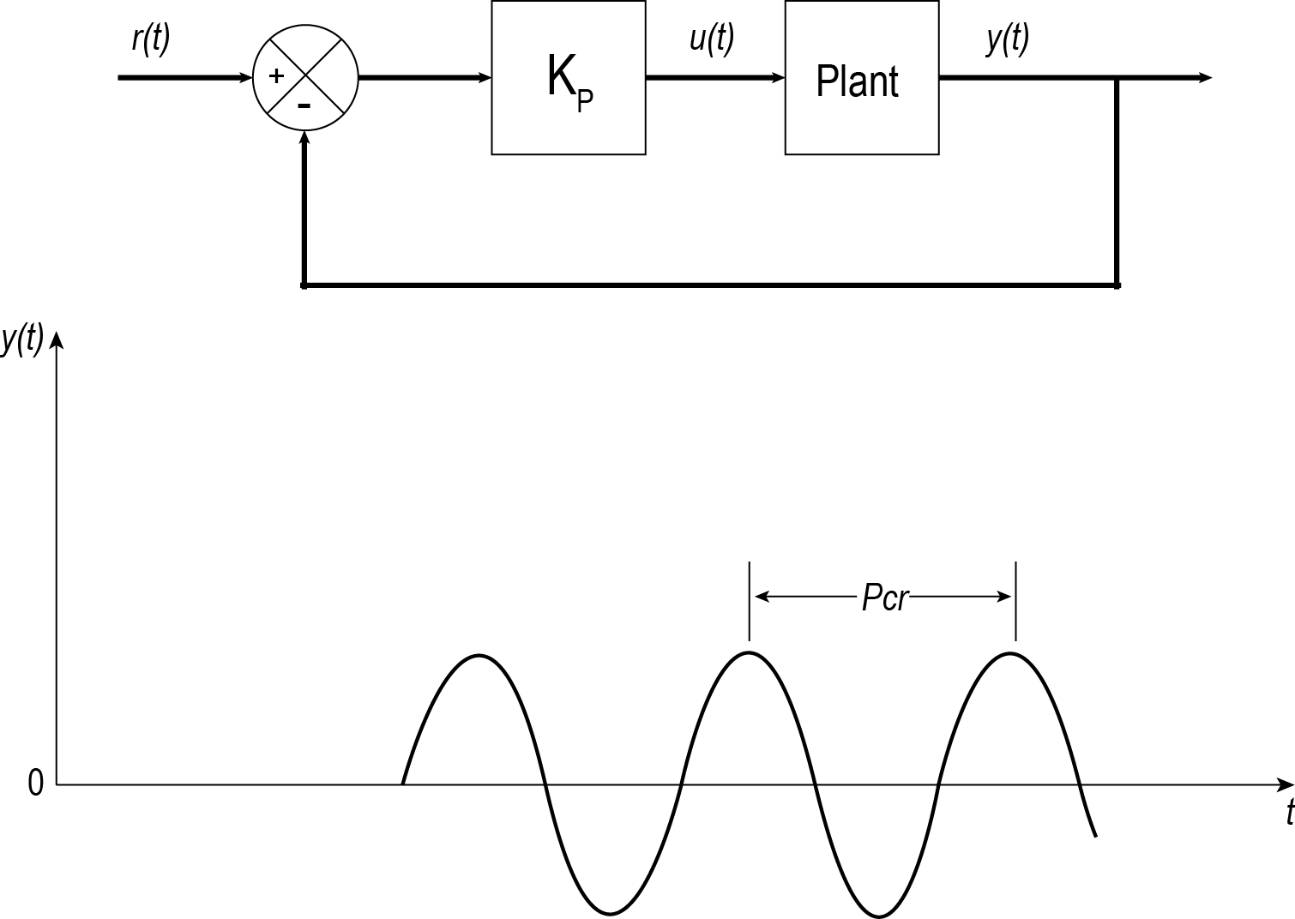
Ziegler Nichols
Second Method
Increase Kp until closed-loop system is on the verge of instability, use critical gain and resulting period
Type of Control | Kp | Ti | Td
P | 0.5Kcr | - | -
PI | 0.45Kcr | Pcr/1.2 | -
PID | 0.6Kcr | 0.5Pcr | 0.125Pcr

Slide 18
Numerical Optimization
Test the system over the entire space of possible control gains (for a specific input)
Can do for a specifically defined cost function
Some standard Performance Indices exist too
Ex:
MATLAB can perform this type of optimization

Slide 19
Controller Implementation
The first feedback systems implemented their control “algorithms” mechanically (ex. Flyball governor, toilet float, thermostat)
Today algorithms are implemented in electronics or more commonly software

Slide 20
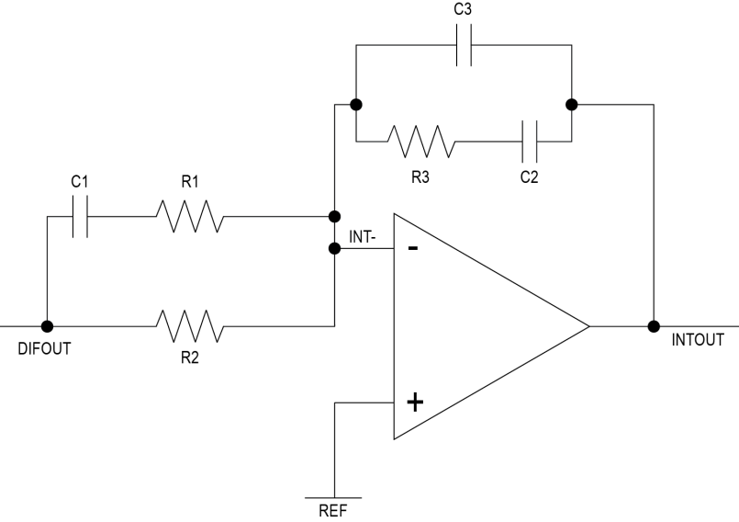
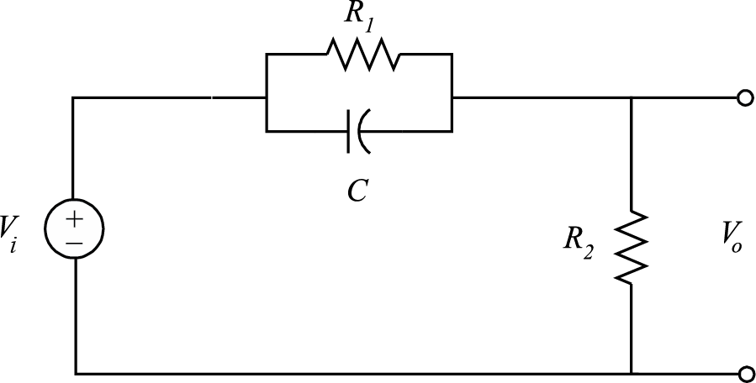
Analog Implementation
Control “algorithms” can be implemented in electronics
Passive circuit – resistors, capacitors, inductors, not powered
Ex: filters, lead and lag compensators
Active circuit – includes operational amplifier, external power
Ex: integrators, differentiators, for isolation

Slide 21
Digital Implementation
Implement control algorithm in software – more adaptable, can implement nonlinear and binary logic easily
Requires control algorithms to be implemented digitally
input must be sampled
output must be held
equations must be discretized
Automatic code generation

Slide 22
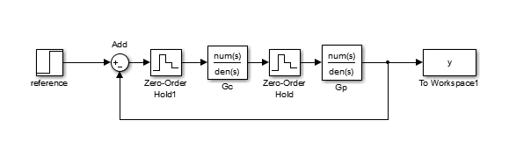
Digital Implementation
Sampling the input is analog to digital conversion
Holding the output is digital to analog conversion
Converting from to analog to digital adds delay and quantization error (consider our lab), introduces aliasing

Slide 23
Digital Implementation
Converting continuous models to digital
Differential equations → difference equations
Laplace transform → z-transform
How to design?
Design in continuous domain and convert (better ways than above), design directly in digital domain

